Slide 1

Exploratory Statistical Analysis of Clinical and Lifestyle Indicators for Early Health Risk DSA0405 – Fundamentals of Data Sciences
GUIDED BY:
Dr. Krishna raj Mony
Associate Professor / CSE SIMATS ENGINEERING
CHENNAI
PRESENTED BY:
A. Reddy Prasad (192472045) M .V. Raghavan (192424373) N. Harshavardhan (192324189)
Vishaal M S (192424420)

Slide 2


Introduction
Early health risk prediction helps identify people who may develop health problems in the future.
Health conditions can be influenced by both clinical factors and lifestyle habits.
Clinical indicators include blood pressure, blood sugar, cholesterol, heart rate, and BMI.
Lifestyle indicators include physical activity, sleep, diet, smoking, and alcohol consumption.
Statistical analysis can be used to study relationships and patterns among these factors.
Exploratory Data Analysis (EDA) helps identify important trends, unusual values, and risk factors in the dataset.
The analysis can help determine which indicators are strongly associated with health risks.

Slide 3
Problem Statement
Health risks are often identified only after symptoms become serious.
Clinical factors such as blood pressure, blood sugar, cholesterol, and BMI can indicate possible health risks.
Lifestyle factors such as diet, exercise, sleep, smoking, and alcohol consumption also affect health.
Statistical analysis can help identify relationships, trends, and important risk factors.
The project aims to explore these indicators and identify people with potential early health risks.
The results can support early intervention and preventive healthcare decisions.

Slide 4
Objectives
To identify the clinical and demographic factors most strongly associated with early health risk using Pearson correlation analysis
To automatically compute descriptive statistics (mean, median, standard deviation, range) for every clinical and lifestyle indicator
To generate analytical visualizations (histograms, correlation charts) illustrating indicator distributions and their relationship with health risk
To provide a clear, transparent statistical risk score describing an individual’s relative risk position against the study population

Slide 5
Literature Review
S. No | Research Paper | Author & Year | Advantages | Disadvantages | Technologies Used
1 | Framingham Study Insights: Statistical Foundations of Cardiovascular Risk Assessment | Kannel & McGee (2023) | Well-established statistical basis; large longitudinal dataset | Older population sample; limited to specific risk factors | Statistical Analysis, Python, Epidemiology
2 | Predictive Analytics for Chronic Disease Risk Assessment Using Clinical Data | Sharma & Iyer (2024) | Identifies key risk indicators effectively; interpretable results | Requires clean, complete clinical data | Statistical Regression, Python, Pandas
3 | Data Mining Approaches for Early Detection of Cardiovascular Risk Factors | Menon et al. (2024) | Surfaces non-obvious risk patterns across large datasets | Computationally intensive on very large datasets | Data Mining, Decision Trees, Python
4 | A Data-Driven Framework for Lifestyle-Based Health Risk Scoring | Nair & Das (2025) | Combines lifestyle and clinical factors; transparent scoring | Sensitive to self-reported lifestyle data accuracy | Data Analytics, Correlation Analysis
5 | Statistical Modeling for Early Diabetes Risk Prediction Using Health Records | Krishnan et al. (2025) | Strong statistical grounding; explainable risk factors | Domain-specific; needs adaptation for other conditions | Logistic Regression, Statistical Modeling

Slide 6
Methodology
Tools & Frameworks
Python, Pandas, NumPy
SciPy (statistics module)
FastAPI, Chart.js
Framingham Heart Study dataset
Data Collection
Health data is collected from:
Kaggle health dataset
Clinical records
Lifestyle surveys
Statistical Techniques Used in Project
Pearson Correlation Analysis
Descriptive Statistics
Significance Testing (p-value)
Percentile-Based Risk Scoring
Median / Mode Imputation
Categorical Encoding
Outcome-Group Comparison (t-test)

Slide 7
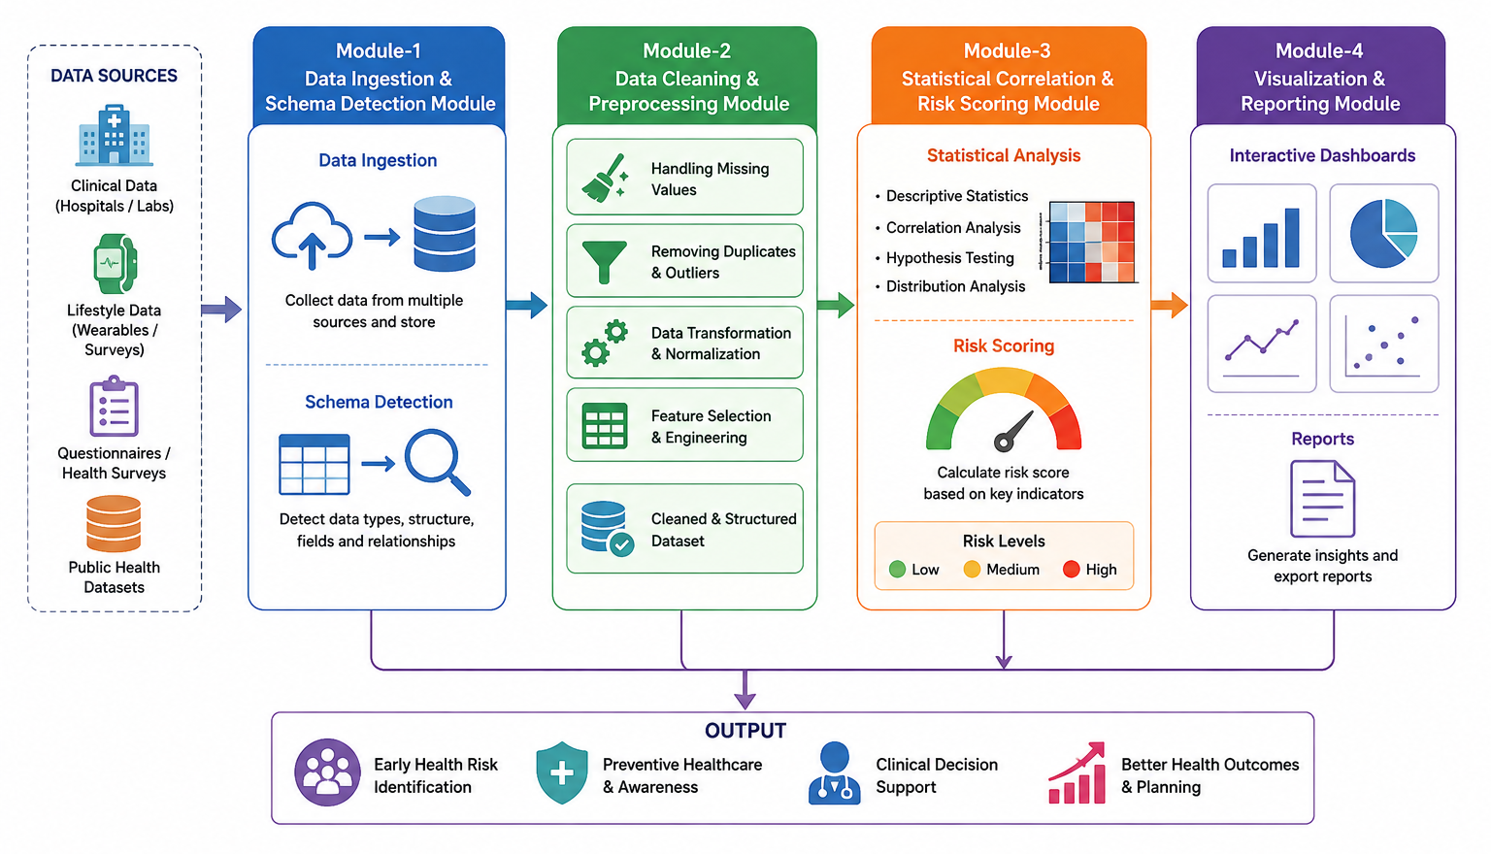
System Architecture

Slide 8
Module-1 Data Ingestion & Schema Detection
Purpose
This module ingests the uploaded health dataset and automatically detects its schema, including the binary outcome column.
Core Functions
Outcome-column detection
Categorical field encoding
Identifier-column filtering
Outputs
Validated, analysis-ready dataset
Encoded feature set
Algorithms / Techniques Used
Name-based & structural target detection
Label Encoding (factorization)
Uniqueness-based Identifier Filtering

Slide 9
Module-2 Data Cleaning &Preprocessing
Purpose
This module cleans the ingested dataset to make it suitable for statistical analysis.
Core Functions
Missing-value imputation
Feature-type classification
Dataset validation
Outputs
Structured, cleaned dataset
Feature-type map (numeric / binary)
Algorithms Used
Median Imputation (numeric fields)
Mode Imputation (categorical fields)
Feature-Type Classification (binary vs numeric)
Dataset Validation & Consistency Checks

Slide 10
Module-3 Statistical Correlation & Risk Scoring
Purpose
This module applies Pearson correlation and statistical significance testing to compute a transparent health-risk score.
Core Functions
Correlation computation
Statistical significance testing
Risk-score calculation
Outputs
Correlation coefficients & p-values
Statistical risk percentile
Algorithms Used
Pearson Correlation Coefficient
Independent Significance Testing (p-value)
Correlation-Weighted Z-score
Percentile Ranking Against Study Population

Slide 11
Module-4 Visualization & Reporting
Purpose
This module provides an interactive dashboard to visualize statistical results and risk-score insights.
Core Functions
Statistical data visualization
Outcome-group comparison
Risk-score reporting
Outputs
Graphs and dashboards
Transparent risk-score breakdown
Algorithms / Techniques Used
Data Visualization (Chart.js)
Outcome-Group Comparison Plotting
Correlation Chart Rendering

Slide 12
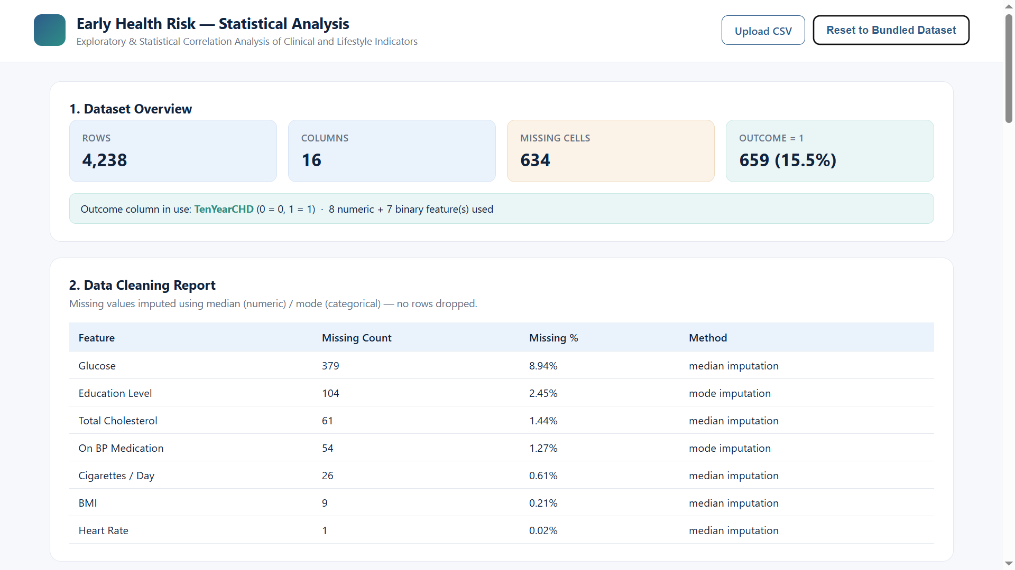
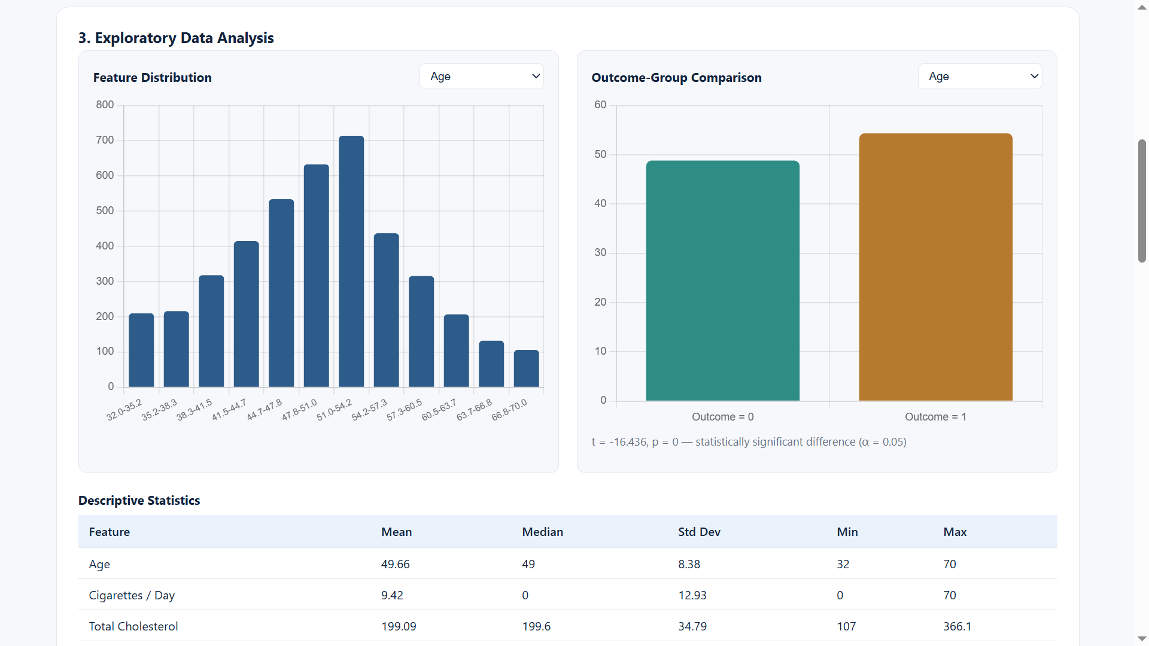
Implementation

Slide 13
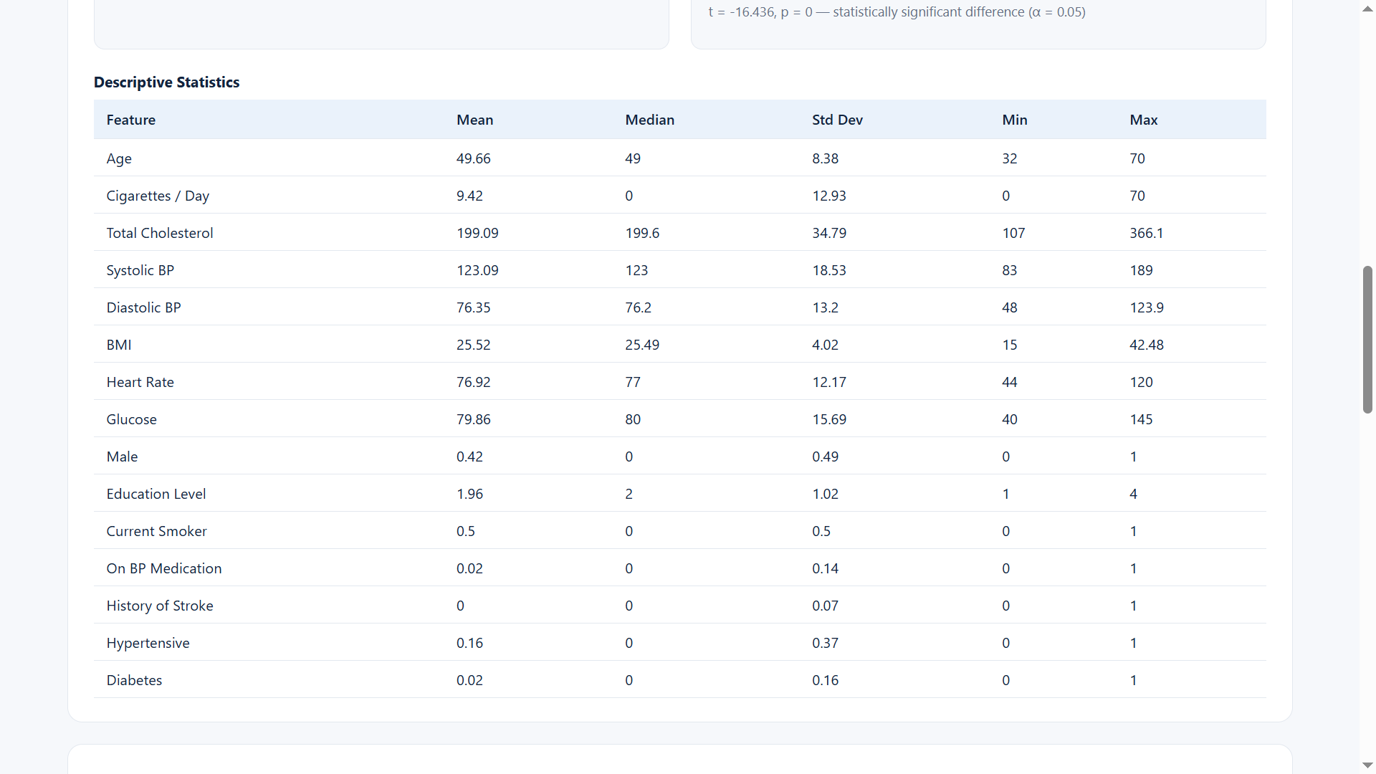
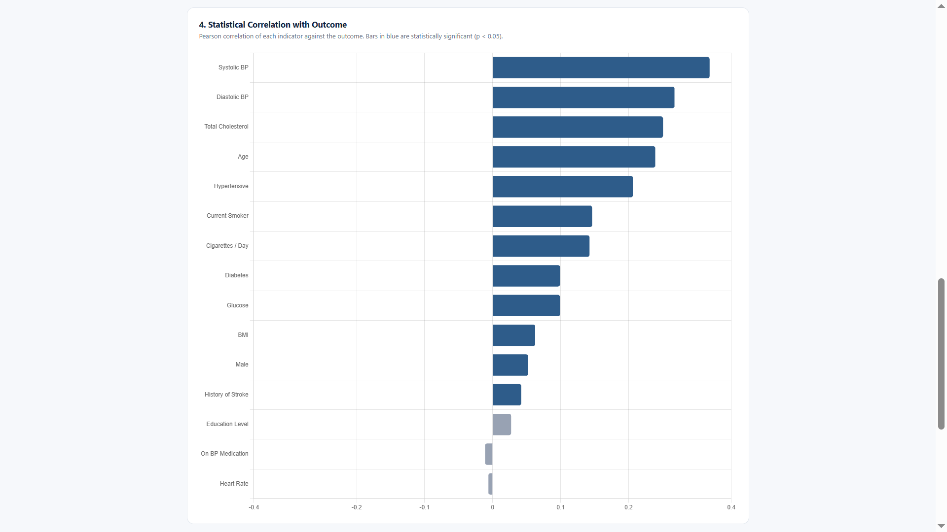
Implementation

Slide 14
Application
Early Health Risk Detection – Identifies possible health risks before serious symptoms appear.
Preventive Healthcare – Helps people take preventive actions based on risk factors.
Patient Monitoring – Tracks changes in clinical and lifestyle indicators over time.
Lifestyle Improvement – Helps identify unhealthy habits such as poor diet, lack of exercise, or inadequate sleep.
Healthcare Decision Support – Provides useful information to doctors and healthcare professionals.
Health Awareness – Helps individuals understand factors that may affect their health.

Slide 15
Conclusion
The project analyzes clinical and lifestyle indicators to understand early health risks.
Statistical analysis helps identify important patterns, trends, and relationships in the data.
Factors such as BMI, blood pressure, blood sugar, physical activity, sleep, and diet can provide useful health insights.
The analysis helps identify major risk factors at an early stage.
Early identification can support preventive measures and healthier lifestyle choices.
Overall, the project demonstrates how exploratory statistical analysis can support early health risk assessment.

Slide 16
REFERENCES
• Lloyd-Jones, D. M., Larson, M. G., Beiser, A., & Levy, D. (2002). Lifetime risk of developing coronary heart disease. The Lancet, 360(9335), 89–92.
• D'Agostino, R. B., Grundy, S., Sullivan, L. M., & Wilson, P. (2001). Validation of the Framingham coronary heart disease prediction scores: Results of a multiple ethnic groups investigation. JAMA, 286(2), 180–187.
• World Health Organization. (2021). Cardiovascular diseases (CVDs): Key facts. World Health Organization.
• Harris, C. R., Millman, K. J., van der Walt, S. J., et al. (2020). Array programming with NumPy. Nature, 585, 357–362.
• McKinney, W. (2010). Data structures for statistical computing in Python. Proceedings of the 9th Python in Science Conference, 56–61.

Slide 17
Future Scope
Machine learning can be added to predict health risks more accurately.
Wearable devices can provide continuous health data such as heart rate and activity.
The system can suggest suitable diet, exercise, and lifestyle changes.
A mobile app can allow users to monitor their health indicators easily.
More diverse and larger datasets can improve the reliability of the analysis.
The system can be extended to identify risks for diseases such as diabetes and heart disease.
The system can be connected with electronic health records for better monitoring.

Slide 18


